Slide 1
Computer Organization Principles
School of Software, Dalian University of Technology
Chi Lin (林驰)
chilin@mail.dlut.edu.cn

Slide 2
Chapter Four: Instruction Systems
Instruction Encoding (指令编码)
Addressing Modes and Formats(寻址方式)
Instruction Usage (指令使用方法)
RISC

Slide 3
Instruction Usage
Condition Codes
Accessing the Condition Codes
Jump Instructions and Their Encodings
Translating Conditional Branches
Loops
Stack Frame Structure

Slide 4
Straight-line code vs conditional execution.

Slide 5
Condition Code
CPU maintains a set of single-bit condition code registers describing attributes of the most recent arithmetic or logical operation. These registers can then be tested to perform conditional branches. The most useful condition codes are:
CF: Carry Flag. The most recent operation generated a carry out of the most significant bit. Used to detect overflow for unsigned operations.
ZF: Zero Flag. The most recent operation yielded zero.
SF: Sign Flag. The most recent operation yielded a negative value.
OF: Overflow Flag. The most recent operation caused a two’s-complement overflow—either negative or positive.

Slide 6
How to set the condition codes ?
All the instructions in Figure 3.7 cause the condition codes to be set.

Slide 7
How to set the condition codes ?
In addition to the setting of condition codes by the instructions of Figure 3.7, there are two instruction classes (having 8, 16, and 32-bit forms) that set condition codes without altering any other registers; these are listed in Figure 3.10.

Slide 8
How to set condition codes?
Oh yeah, we know how to set the condition codes, but how can we access them?
Then the condition codes would be set according to the following C expressions:
CF: (unsigned) t < (unsigned) a Unsigned overflow
ZF: (t == 0) Zero
SF: (t < 0) Negative
OF: (a < 0 == b < 0) && (t < 0 != a < 0) Signed overflow

Slide 9

Accessing the Condition Codes
Three common ways of using the condition codes:
We can set a single byte to 0 or 1 depending on some combination of the condition codes,
We can conditionally jump to some other part of the program, or
We can conditionally transfer data.

Slide 10

Jumping Instruction
A jump instruction can cause the execution to switch to a completely new position in the program. These jump destinations are generally indicated in assembly code by a label.

Slide 11
Jumping Examples

Slide 12
Translating Conditional Branches
The most general way to translate conditional expressions and statements from C into machine code is to use combinations of conditional and unconditional jumps.

Slide 13
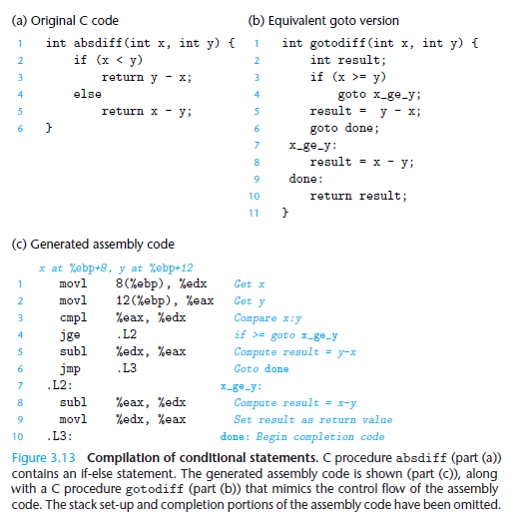
Translating Conditional Branches

Slide 14
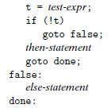

if-else statement Translation

Slide 15
Loops
Do-while
While
for

Slide 16


do-while Loop Procedure

Slide 17
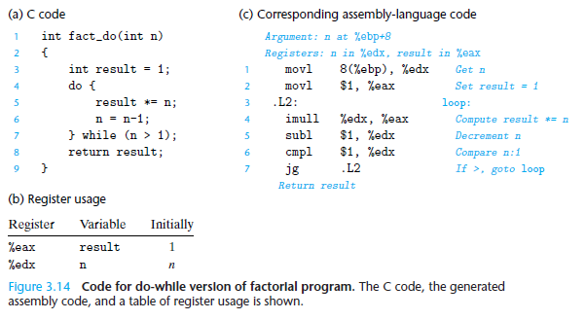
Do-while Example

Slide 18
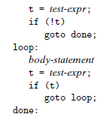
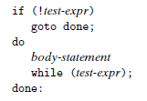

While Loop Procedure

Slide 19
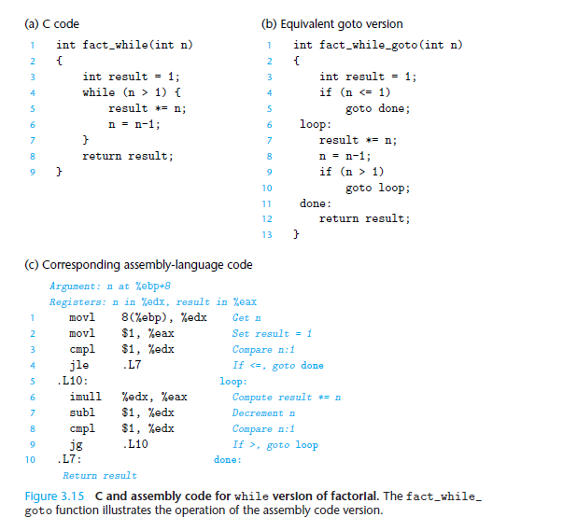
While Example

Slide 20


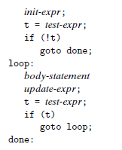
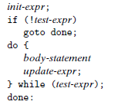
For Loop Procedure

Slide 21
Procedures
A procedure call involves passing both data and control from one part of a program to another. In addition, it must allocate space for the local variables of the procedure on entry and deallocate them on exit.
Call & ret
Stack frame

Slide 22
Stack Frame Structure
IA32 programs make use of the program stack to support procedure calls. The machine uses the stack to
pass procedure arguments
store return information
save registers for later restoration
for local storage.
The portion of the stack allocated for a single procedure call is called a stack frame.

Slide 23
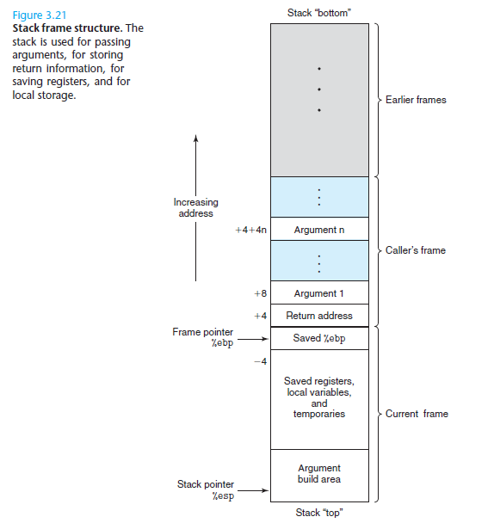
Stack Frame （栈帧）

Slide 24
Two important registers in Stack Frame
The topmost stack frame is delimited by two pointers, with register %ebp serving as the frame pointer(帧指针), and register %esp serving as the stack pointer(栈指针).
The stack pointer can move while the procedure is executing, and hence most information is accessed relative to the frame pointer.

Slide 25
Transferring Control
The call instruction has a target indicating the address of the instruction where the called procedure starts. Like jumps, a call can either be direct or indirect.
The ret instruction pops an address off the stack and jumps to this location. The proper use of this instruction is to have prepared the stack so that the stack pointer points to the place where the preceding call instruction stored its return address.

Slide 26
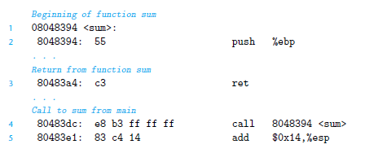
An Example of call & ret

Slide 27
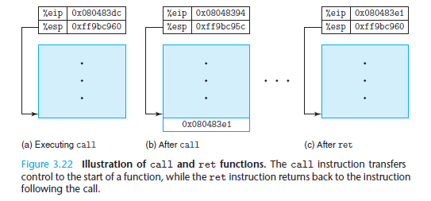
Behaviors of PC & Stack Pointer

Slide 28
Stack Frame Example

Slide 29
Stack Frame Example

Slide 30
Chapter Four: Instruction Systems
Instruction Encoding (指令编码)
Addressing Modes and Formats(寻址方式)
Instruction Usage (指令使用方法)
RISC

Slide 31
Instruction Set Architecture
Types of ISA and examples:
RISC -> Playstation
CISC -> Intel x86
MISC -> INMOS Transputer
ZISC -> ZISC36
SIMD -> many GPUs
EPIC -> IA-64 Itanium
VLIW -> C6000 (Texas Instruments)

Slide 32
Instruction Set Architecture
CISC – Complex Instruction Set Computer
RISC – Reduced Instruction Set Computer

Slide 33
Problems of the Past
In the past, it was believed that hardware design was easier than compiler design
Most programs were written in assembly language
Hardware concerns of the past:
Limited and slower memory
Few registers

Slide 34
The Solution
Have instructions do more work, thereby minimizing the number of instructions called in a program
Allow for variations of each instruction
Usually variations in memory access
Minimize the number of memory accesses

Slide 35
CISC
Each instruction executes multiple low level operations
Ex. A single instruction can load from memory, perform an arithmetic operation, and store the result in memory
Smaller program size
Less memory calls

Slide 36
The Search for RISC
Compilers became more prevalent
The majority of CISC instructions were rarely used
Some complex instructions were slower than a group of simple instructions performing an equivalent task
Too many instructions for designers to optimize each one

Slide 37
Smaller instructions allowed for constants to be stored in the unused bits of the instruction
This would mean less memory calls to registers or memory

Slide 38
RISC Architecture
Small, highly optimized set of instructions
Uses a load-store architecture
Short execution time
Pipelining
Many registers

Slide 39
Load/Store Architecture
Individual instructions to store/load data and to perform operations
All operations are performed on operands in registers
Main memory is used only to load/store instructions

Slide 40
RISC vs CISC
Less transistors needed in RISC
RISC processors have shorter design cycles
RISC instructions take less clock cycles than CISC instructions
CISC instructions take up to 3 to 12 times longer
Smaller instructions allowed for constants to be stored in the unused bits of the instruction
This would mean less memory calls to registers or main memory

Slide 41
Without Pipelining
Normally, you would peform the fetch, decode, execute, operate, and write steps of an instruction and then move on to the next instruction

Slide 42





Without Pipelining
Clock Cycle 1 2 3 4 5 6 7 8 9 10
Instr 1
Instr 2

Slide 43
With Pipelining
The processor is able to perform each stage simultaneously.
If the processor is decoding an instruction, it may also fetch another instruction at the same time.

Slide 44
With Pipelining
Clock Cycle 1 2 3 4 5 6 7 8 9
Instr 1
Instr 2
Instr 3
Instr 4
Instr 5

Slide 45
Pipeline (cont.)
Length of pipeline depends on the longest step
Thus in RISC, all instructions were made to be the same length
Each stage takes 1 clock cycle
In theory, an instruction should be finished each clock cycle

Slide 46
Why CISC Persists
Most Intel and AMD chips are CISC x86
Most PC applications are written for x86
Intel spent more money improving the performance of their chips
Modern Intel and AMD chips incorporate elements of pipelining
During decoding, x86 instructions are split into smaller pieces

Slide 47
Homework
Review Chapter 3.1~3.7
Preview Chapter 4
Practice Problem 3.16-3.24, 3.31, 3.34
You don’t need to grasp the assembly language, but you need to understand an assembly program.

Slide 48
Thank You

